Slide 1
Best Buy Mobile Web
DATE: 15 April 2019
PROJECT NAME: Machine Learning and Human Buying Behavior
NAME: Mandeep Narang
Yajaira Gonzalez
Sunny Yadav
Soren Thomsen
Nirlep Shah

Slide 2
Project Motivation
WHY?
Obtain real world experience in resolving and uncovering online business opportunities from data Big Data analysis
OBJECTIVE
Predict which Best Buy product a mobile web visitor will be most interested in based on their search query or behavior over 2 years
Provide Best Buy with additional implications from deep dive exploration analysis
PLAN
Research → Best in class solutions of recommender engines
Data Cleaning → Clean the data and set up final file for analysis & exploration
EDA → Explore Best Buy data to uncover nuances
Analysis → Team’s approach in building the recommender system
Results → Share learnings & implications for Best Buy

Slide 3
RESEARCH
Best Practices & Concepts

Slide 4
Recommendation Systems
Different architectures for a recommender system:
Popularity Based Recommender Make the same recommendation to every user, based on the popularity of an item.
Content-Based Recommender focus on properties of items. Similarity of items is determined by measuring the similarity in their properties. Different types of content-based systems:
Classification/Regression
Item content similarity (Jaccard similarity, cosine similarity)
Word2Vec
Collaborative Filtering Recommender focus on the relationship between users and items. Similarity of items is determined by the similarity of the ratings of those items by the users who have rated both items.
Item-item similarity
User-user similarity
Matrix Factorization
Notes:
called Collaborative Filtering methods because, we filter objects based on the similarities in behavior using "collaboration" between users or items.

Slide 5

Amazon
User-user similarity
Item-item similarity

Slide 6
Netflix
Collaborative filtering recommenders (item & user similarity)

Slide 7
Matrix Factorization - Utility Matrix
Example: User based recommender
Computes the similarity between a given user and other users by comparing rows of this matrix.
The actual comparison method could be a dot product [for example: A.B = 4x2 + 5X0 + 5x0 + 1x3 ... etc] called Cosine similarity or a correlation coefficient between rows A and B called Pearson similarity.
The heart of the item/user dataset is what is the utility matrix. MF decomposes a large matrix into products of matrices.
List of Rated Items
Users who Rated

Slide 8
DATA CLEANING & SETUP

Slide 9
Available Information for Analysis
Two CSV (“Train.csv” & “Test.csv”)
“Train.csv” : the user, sku, time stamp, category, and query details
“Test.csv” : the user, different sku, the dataset to make the product recommendation
Three XML folders of data: 8GB
Product: Information regarding product details most importantly the name, price, sku
(256 files) col 140 x rows 5000
Categories: Product sku, category name, etc
(50 files) col 50 x rows 1000.
Reviews: Product review data; comments, reviews, ratings, etc.
(150 files) col 50 x rows 1000

Slide 10
Tools & Packages used
Stack
Scikit-learn
Pandas
Numpy
Spark Ml - Lib
Surprise
Thinkstat
Thinkplot
Modeling/Machine Learning
Data Visualization
Plotly
Interactive
Matplotlib
Seaborn
Pyspark
Python

Slide 11
Data Cleaning
Reading
Cleaning
Process
Using Pyspark & Python to read in the data
Using Pyspark & Python to join data files into one dataframe and setting up data for analysis
Challenge
Data in XML vs CSV
Inefficient processing speed (25 mins per file)
Originally, 2 hours process of joining files
Solutions
Identified primary columns needed for analysis
Partition file horizontally, process & export (1.5 mins for each file)
Changing joining operator to be more efficient, 5 sec join

Slide 12
DATA EXPLORATION
Visualization & Text Analysis

Slide 13
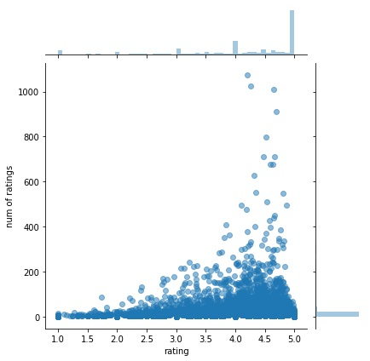
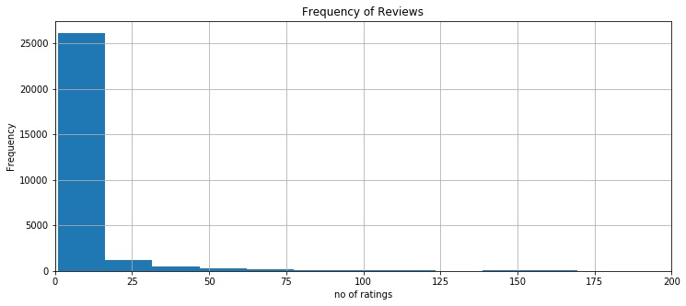
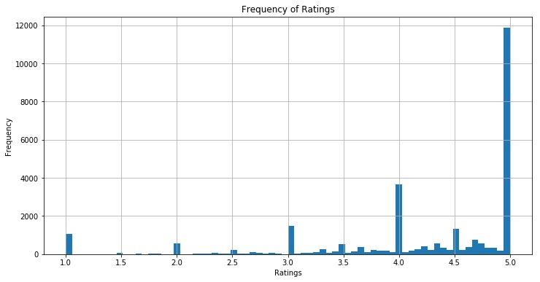
Ratings
Topic of Exploration
Understanding Frequency of Reviews
Rating Overview
Rating & Review Density
Learnings
Frequency of reviews is limited, which limits analysis
Reviews are skewed more positively

Slide 14
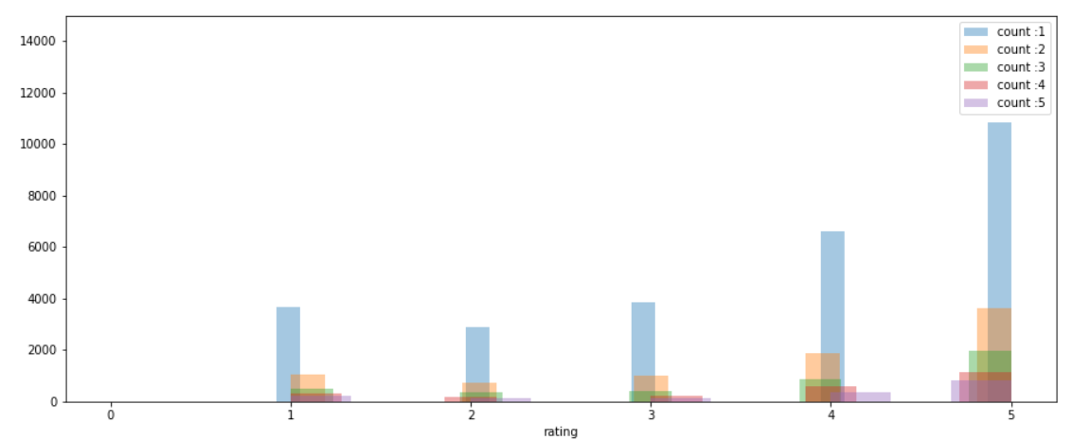
# of Ratings by Product Count
High frequency of products with only one review, a large portion of those products have a 5 star rating

Slide 15
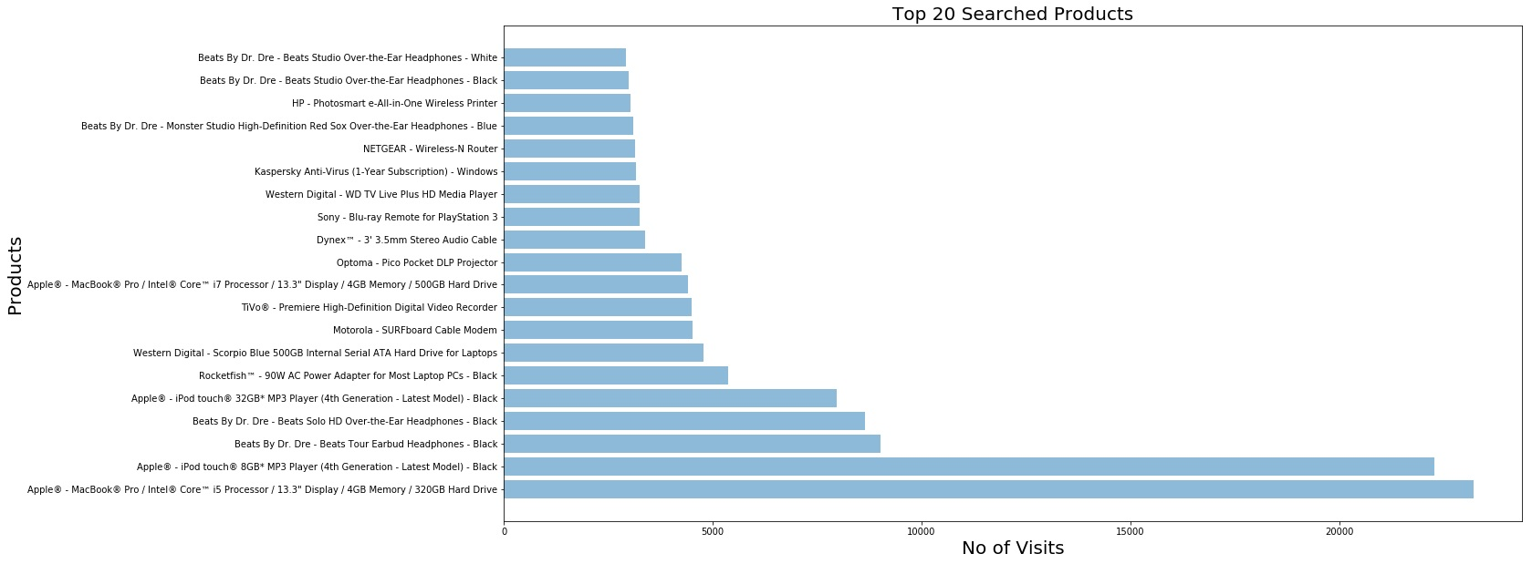
Product frequency

Slide 16
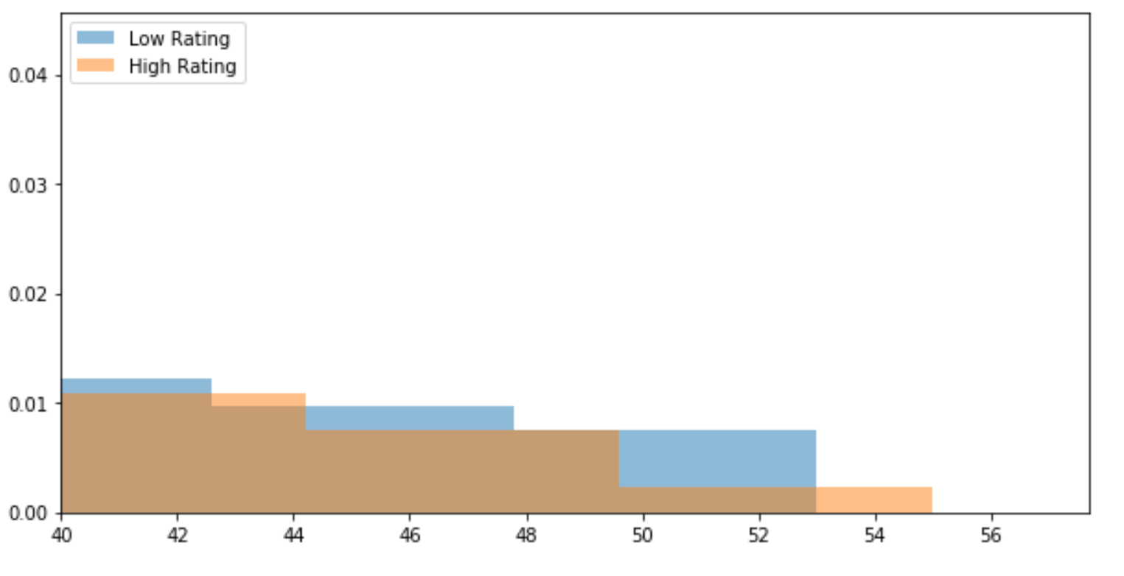
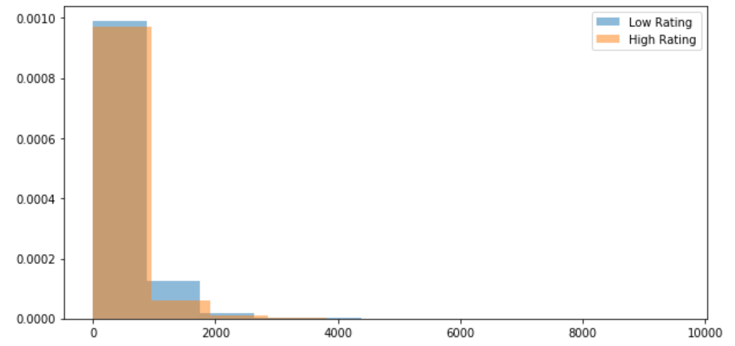
Reviews - Text Exploration
Title - Length Count Exploration
Comment - Length Count Exploration
We can see the low rating bar is higher, meaning low ratings cause customers to write more than happy customers

Slide 17
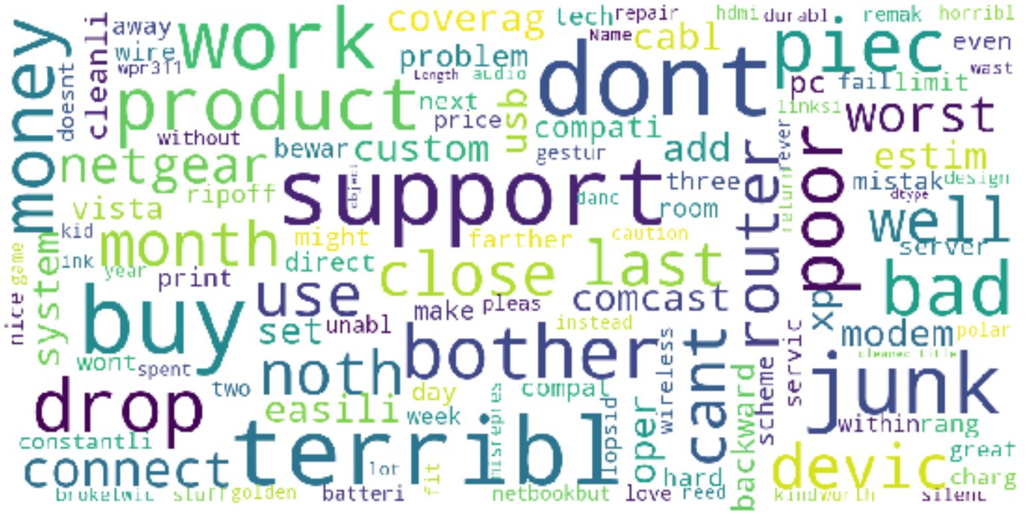
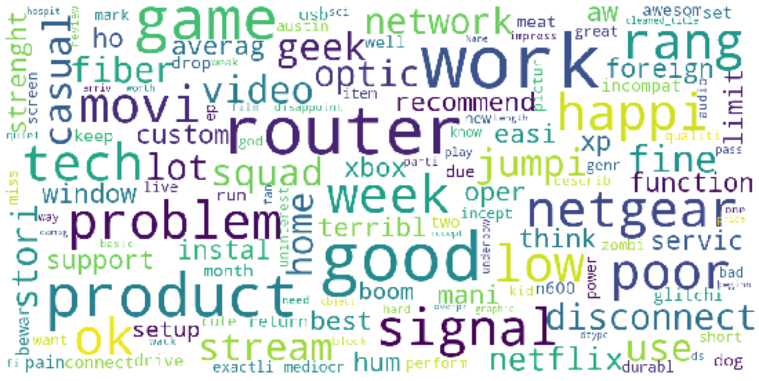
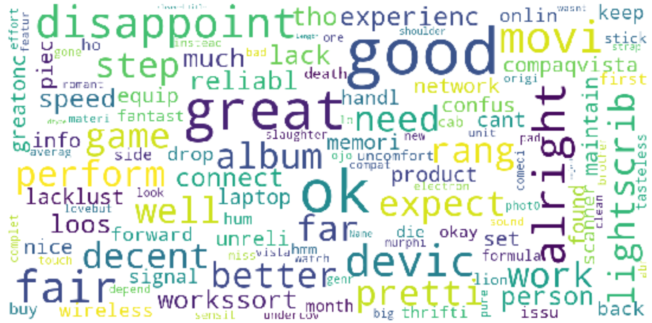
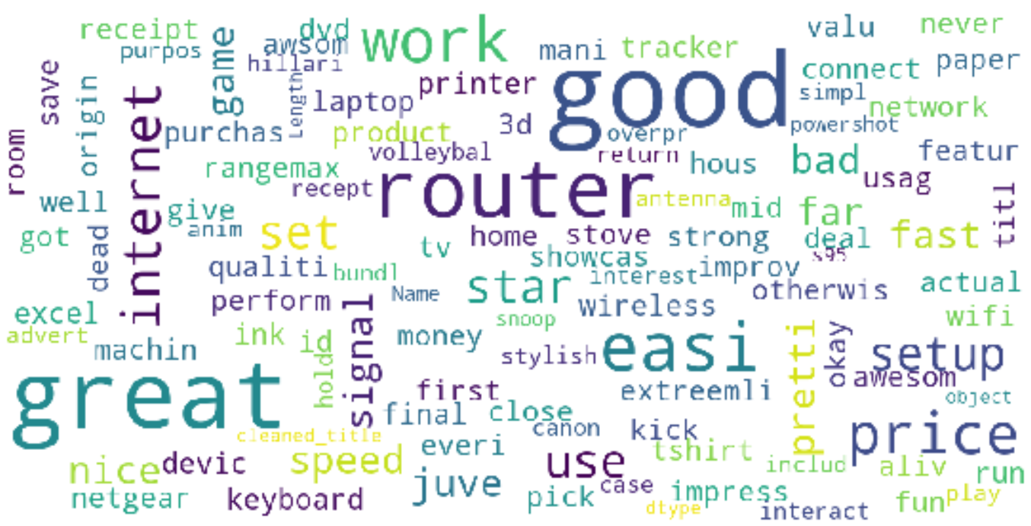
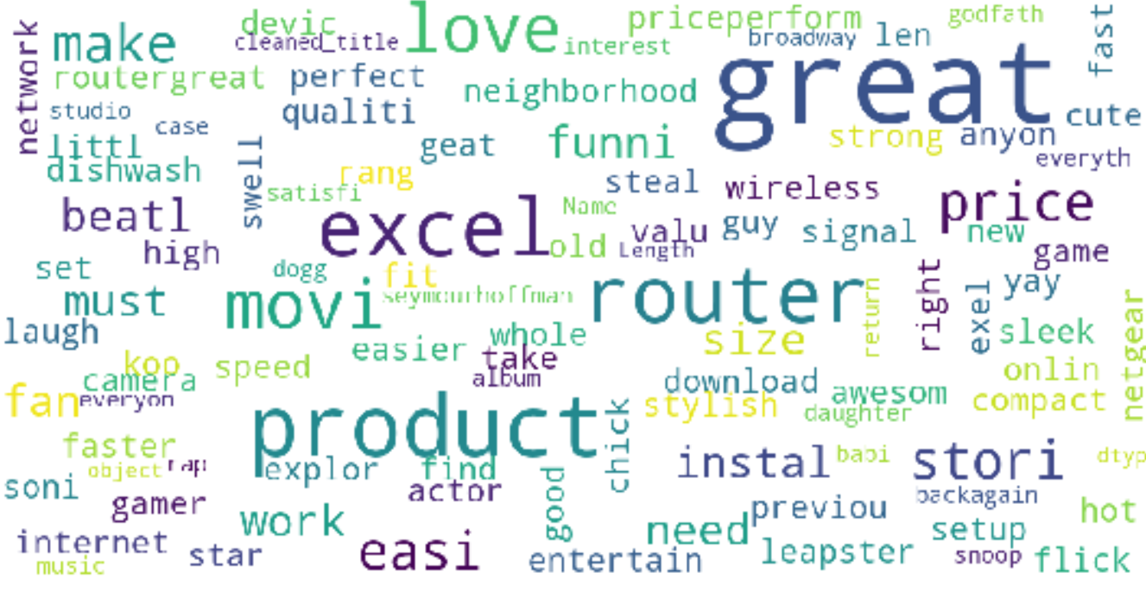
Reviews - Word Cloud Visualization
Rating: 1
Rating: 2
Rating: 3
Rating: 4
Rating: 5
Learnings: We see some items trend like “router” “netgear” which pose question of item quality

Slide 18
ANALYTICS & RESULTS
Application of Concepts

Slide 19
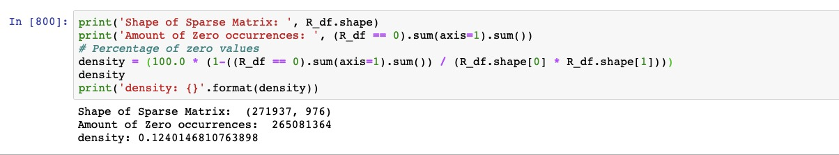
Best Buy Data & MF Strategy
Insights:
Best Buy Data is not optimal for recommender system due to large gaps across rating and user based matrixes
Directs our analysis to find tools to help us fill in gaps used in the MF process for our item and user matrixes
Run an item-item similarity model & a user-user similarity model to obtain recommendations

Slide 20
Matrix Factorization - Steps to goal
STEPS
WHY?
Data Splitting: Stratified Sampling | Helps in identifying key sample group to make inferenced ratings
Stochastic Gradient Descent; Starting with random numbers | Optimizer; makes recommendations more precise and efficient
Predicting and optimizing/minimizing RMSE for already present ratings/flag in the matrix on Training Data | Evaluates the performance of our proposed method by using the root mean square error (RMSE) as a quantitative evaluation measure
Prediction for the Test Data | Be able to create predicted rating values after the Model is ran
1.
2.
3.
4.

Slide 21
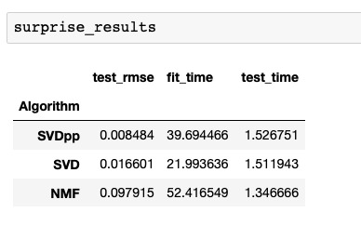
Surprise Results - Quick Results
Best Buy Matrix Data - Results
Surprise is a Python Library that helps us analyze recommender systems
Provide tools to evaluate, analyse and compare the algorithms performance. Cross-validation procedures can be run very easily using powerful CV iterators

Slide 22
ALS - Alternating Least Squares
ALS is implemented in Apache Spark ML and built for a larges-scale collaborative filtering problems. A Matrix factorization algorithm that uncovers the latent features through matrix multiplication.
Why ALS? Helpful in solving scalability and sparseness of the ratings data, and it’s simple and scales well to very large datasets.
Uses L2 regularization
Minimizes two loss functions alternatively; It first holds user matrix fixed and runs gradient descent with item matrix; then it holds item matrix fixed and runs gradient descent with user matrix
Scalability: ALS runs its gradient descent in parallel across multiple partitions of the underlying training data from a cluster of machines

Slide 23
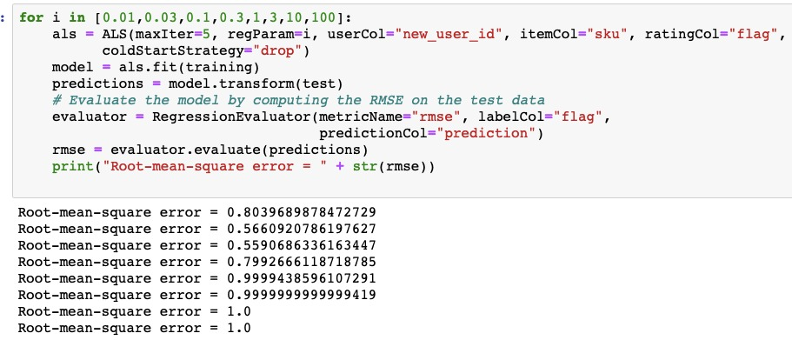
ALS - Estimate Results

Slide 24
BEST BUY - RECOMMENDATION MODEL
{IN CODE DEMONSTRATION}

Slide 25
Best Buy Key Business Opportunities
Provide transactional data to be able to conduct an association analysis and flesh out the recommendation model further
Consider a deep dive on product quality from associated negative reviews
Provide incentives to obtain customer reviews to build better reco models

Slide 26
QUESTIONS?

